Slide 1
DNA Replication

Slide 2
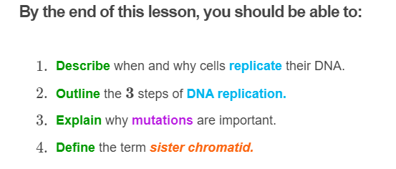
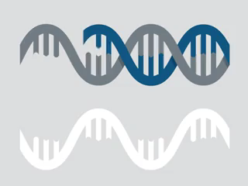

Slide 3
Our body is constantly producing new cells.
To do this, one parent cell is split into two daughter cells. This process is called cell division.

Slide 4
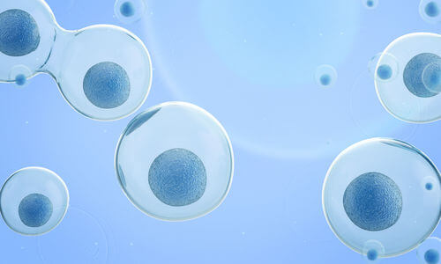
There are two types of cell division: mitosis and meiosis.
They have slightly different steps, but both make new cells by dividing old cells.

Slide 5
Before a cell undergoes mitosis or meiosis, it needs to make a copy of its DNA.
This process is called DNA replication.
DNA replication leaves the parent cell with two copies of its DNA. Each copy contains one strand of the original DNA and one new strand.

Slide 6
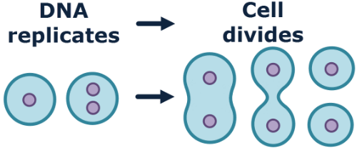
This is important, because each daughter cell needs a copy of the parent cell's DNA.
If the parent cell did not replicate its DNA, it would only have one copy to pass on. One of the daughter cells would not have any DNA!
So DNA replication enables each daughter cell to receive one copy of the parent cell's DNA.

Slide 7
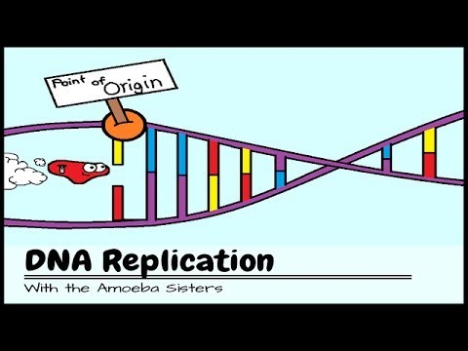

Slide 8
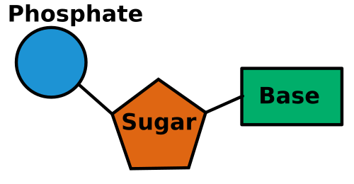
We are going to learn about how a cell replicates its DNA, but first we need to review the structure of DNA.
The basic, repeating unit of DNA is the nucleotide.
Each nucleotide is composed of a deoxyribose sugar, a phosphate and a nitrogenous base.

Slide 9
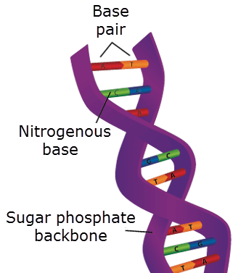
Several nucleotides are connected by their sugar and phosphate groups to make two sugar phosphate backbones.
The two backbones are connected by base pairs, which are two nitrogenous bases bonded together.

Slide 10
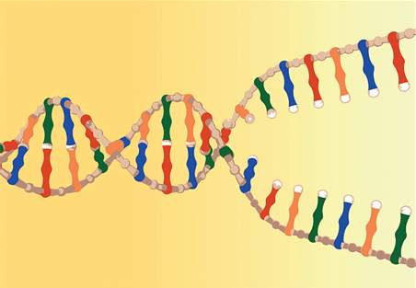
Now that we have reviewed the structure of DNA, we can learn how it is replicated.
The first thing the cell does is unwind the double helix.
It does this by cutting the base pairs that connect the sugar phosphate backbones. This exposes the nitrogenous bases of each strand.

Slide 11
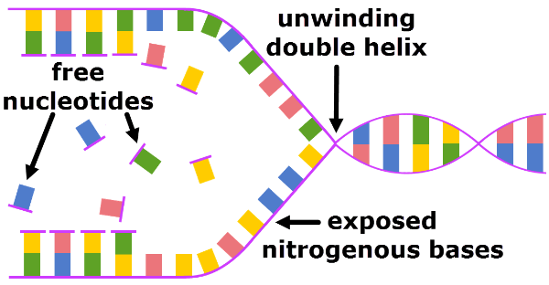
The cell can then bond new nucleotides to the exposed bases.
These nucleotides were floating around the nucleus waiting to be used.
Nucleotides are added following the complementary base pair rule: adenine to thymine and cytosine to guanine.

Slide 12
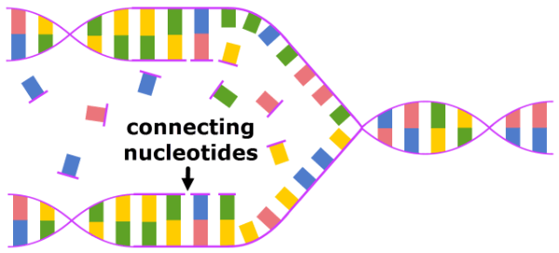
Finally, the new nucleotides bond together to form a chain.
They are connected to one another by binding the sugar of one nucleotide to the phosphate group of the next. This makes the new sugar phosphate backbones.

Slide 13
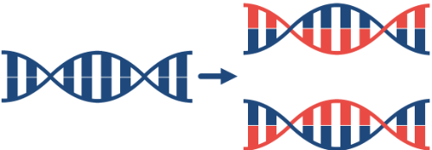
When replication is finished, there are two pieces of DNA.
Each contains one old strand and one new strand. They have identical nucleotide sequences to each other and to the original double strand of DNA.

Slide 14
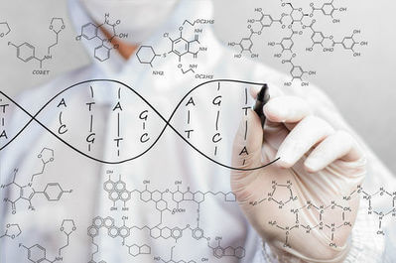
Sometimes mistakes are made when replicating the DNA.
For instance, an adenine (A) might be added to a cytosine (C), like in the picture below.
This violates the complementary base pair rule, which states that adenine always binds to thymine and cytosine to guanine.
These mistakes are called mutations.

Slide 15
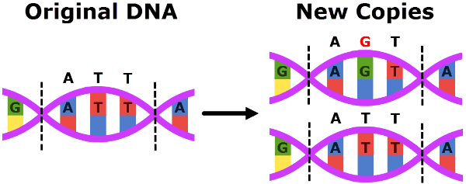
Mutations can change the nucleotide sequence of a gene.
In the picture below, a mutation occurred in one of the new DNA strands. During replication, a guanine was added where a thymine should have been.
This changed the nucleotide sequence from ATT to AGT.

Slide 16
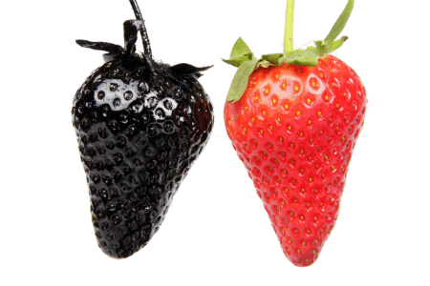
Mutations are important because the nucleotide sequence of a gene is what determines the information it carries.
When mutations change the nucleotide sequence, they can change the information stored in the DNA.
This can change the traits the DNA codes for.

Slide 17
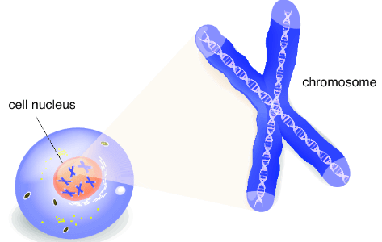
After replication, the chromosomes take on a distinctive X shape.
This is because the two copies of DNA made during replication are attached at the center. The point of attachment is called the centromere.
The left and right sides of the X, referred to as the arms, are each one copy of the chromosome.

Slide 18
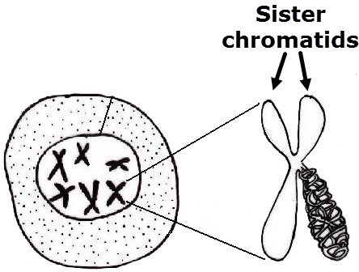
One arm of the X is called a chromatid.
Chromatids from the same chromosome are called sister chromatids.
Sister chromatids are therefore copies of the same chromosome which are attached to form an X shape.

Slide 19
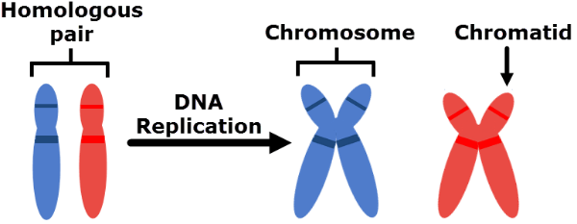
It is easy to confuse homologous chromosomes and sister chromatids, so here is a comparison.
Homologous chromosomes are two similar chromosomes. They have the same genes, but one is from your mother and one is from your father.
Sister chromatids are identical copies of the same chromosome. They are the result of DNA replication.

Slide 20
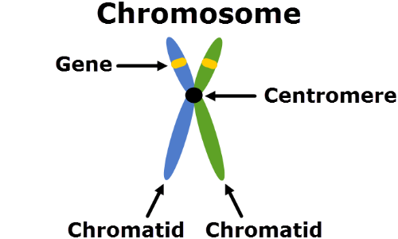
In summary:
1. | After replication, chromosomes look like an X. The left and right sides of the X are attached at the centromere.
2. | Each arm is a copy of the chromosome. They are called chromatids.
3. | Chromatids from the same chromosome are called sister chromatids.

